Slide 1
AI Discovery Cards Workshop Train the Trainer
Date:
Facilitators:
Updated: 09/22/2025
Notes:
Time:
30 seconds
Do:
Present this slide while people join the session.
As an SME, we ask you to take time throughout the workshop to share experiences and encourage other participants to share theirs, and make room for questions.
We want to encourage and give our people the confidence to go out and evangelize the workshop with our partners, to generate solid pipeline for AI projects.
Say:
N/A

Slide 2
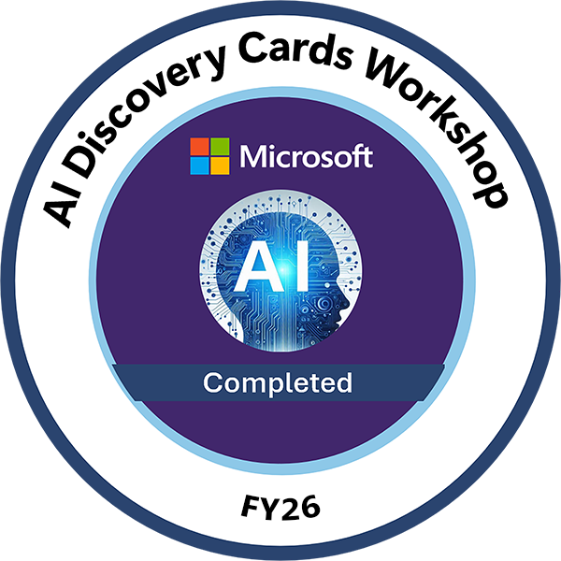






AI Discovery Cards Workshop
Train the Trainer
Virtual Instructor-Led Workshop
TARGET AUDIENCE
Required: PTS, PSA
Recommended: PDM, PSS, MCAPS sellers in ATU, CSU, SMC, and STU
In this interactive, virtually-led workshop, you’ll acquire the skills necessary to train Partners in effectively facilitating Design Thinking workshops focused on AI solutions. This updated version (V2) is designed specifically for employees who either missed the FY25 sessions or would benefit from a refresher to boost their confidence in delivering the workshop to their partners.
The workshop offers a structured and tested approach, incorporating real-world scenarios to help customers explore priorities, define challenges, and visualize AI solutions. Sessions are facilitated by colleagues who have already delivered the workshop to their partners and will share real-delivery best practices, tips & tricks, and recommendations to enrich your learning experience.
KEY TAKEAWAYS
Gain confidence in leading AI Discovery Cards Workshops.
Train Partners to effectively use AI Discovery Cards in customer interactions.
Equip Partners with the skills to guide customer conversations, prioritize topics, and build AI business cases.
Earn your AI Discovery Cards Workshop badge!
MODALITY + DURATION
Virtual Instructor-Led Training (VILT)
~3 hours
CONTINUOS LEARNING
After taking the VILT, tap into the online training to revisit core concepts and deepen your mastery in delivering the AI Discovery Cards delivery to partners.
Start online course here ~1 hour
LAUNCH
Worldwide sessions available in September & October 2025
Sep 30th: EMEA: Register here
Sep 30^{th:} ASIA: Register here
Oct 2nd: AMER: Register here
For additional information, please reach out to Deco Pinheiro | decopin@microsoft.com
Notes:
Time 3 Minutes: Do: Introduce participants to the workshop and our scope. Say: Welcome to the AI Discovery Cards Train-the-Trainer Workshop—an interactive, virtual, instructor-led session designed to equip you with the skills to train Partners in facilitating Design Thinking workshops focused on AI solutions. This workshop provides a structured, real-world-tested approach to help customers explore priorities, define challenges, and visualize impactful AI solutions.
As Copilots and Frontier AI Solutions are central to the Microsoft Customer and Partner Solutions (MCAPS) FY26 strategy, this training is a key enabler of that vision.
Instructor led training is a unique opportunity to learn, so to make the most of it, pleasee:
Join the AIDC community to stay connected and deepen your learning.
Engage in practice sessions to reinforce your facilitation skills.
Ask questions—our trainers are here to support you.
Use the OLT training as a vital companion to this workshop.
and with that, let’s get started!

Slide 3
Pause to read this important message:
This framework is designed as a guide, but it is not a one-size-fits-all solution. For the framework to be effective, you’ll need to apply what you know about your partner, their customers, their business offering portfolio, region, and industry.
The format presented here is designed to complement Microsoft’s common envisioning framework, found in Microsoft Envisioning Experience (MEEx) and the Business, Experience, Technology (BXT) model.
If you’re facilitating virtually, it’s crucial to become comfortable with the whiteboard tool of your choice and familiarize yourself with the AI Discovery cards. Knowing which cards to use and when to use them, based on your specific audience and facilitation goals, will be key to your success.
Notes:
​Time: ​
30 seconds
​
Do:
​Show this slide to the participants. Make sure you read the slide aloud as well.
​
Say: Please take a moment to read this important slide. I will read it aloud for us too.
“This framework is designed as a guide, but it’s not a one-size-fits-all solution. You’ll need to apply what you know about your partner, region, and industry for the framework to be effective. If you’re facilitating virtually, it’s crucial to get comfortable with using Mural and familiarizing yourself with the cards. Understanding which cards to pull and when based on your specific audience and facilitation goals will be key to your success.”

Slide 4
Microsoft Envisioning Experience (MEEx)
AI Discovery Cards can be used in many ways. The format presented here is designed to complement Microsoft's common envisioning framework, as found in MEEx and BXT.
We focus on Business Case and Use Case discovery to feed into technical capability and feasibility, which are not in the scope of this workshop.
We have aligned the outputs to BXT templates to assist with capturing all relevant inputs and outputs, enabling effective prioritization of use cases once the technical assessment is completed.
Notes:
​Time: ​
30 seconds
​
Do:
​Show this slide to the participants. Make sure you read the slide aloud as well. Post resource links (below) in chat.
BXT Use Case Assessment.pptx
Microsoft Envisioning Experience (MEEx) L100 - Subject Matter Expert | Viva Learning
Microsoft Envisioning Experience (MEEx) L200 - Business Envisioning for AI - Practitioner | Viva Learning
​
Say:
AI Discovery Cards can be used in many ways. The format presented here is designed to complement Microsoft's common envisioning framework, as found in MEEx and BXT.
We focus on Business Case and Use Case discovery to feed into technical capability and feasibility, which are not in the scope of this workshop.
We have aligned the outputs to BXT templates to assist with capturing all relevant inputs and outputs, enabling effective prioritization of use cases once the technical assessment is completed.
BXT Use Case Assessment.pptx
Microsoft Envisioning Experience (MEEx) L100 - Subject Matter Expert | Viva Learning
Microsoft Envisioning Experience (MEEx) L200 - Business Envisioning for AI - Practitioner | Viva Learning

Slide 5

Agenda
AI Discovery Cards Workshop: Train the Trainer
Date:
Time:
Location:
Topic | Duration
Introduction & Facilitator Toolbox | 30 min
Workshop activities | 25 min
Break | 10 min
Design Thinking: Example scenario | 15 min
Hands-on exercise: Whiteboard | 40 min
Process overview | 10 min
Break | 10 min
Next steps | 10 min
Wrap up | Questions | 10 min
 | ~3 hours
Notes:
​Time: ​
60 seconds
​
Do:
Go over the agenda with participants. Review how this train the trainer will be facilitated.
Leave it open to the participants to ask questions and feel safe to ask for clarification on points / topics where we assume too much.
We have a little wiggle room in the timings, but do your best to stick to the slide timings and keep the workshop moving. Longer discussion should be moved to the end, or suggested for community or practice session shareback.
​
Say:
We had to make assumptions on timing for this agenda. Please stop us and ask if you need more explanations on the agenda timing.
The goal for today is to experience AI Discovery Cards and to learn how to run the workshop with your partners.
For training our partners, we have a very comprehensive TtT deck which is targeted at taking between 4 to 6 hours for a full day workshop to train partners to deliver.
Your end goal is either to discover innovative AI use cases for your partner to pursue or to enable your partners to deliver the workshop themselves to customers.

Slide 6
Introduction
1

Slide 7

Poll questions
1) What do you believe a CxO's initial thoughts are when they hear the term AI/GenAI?
ChatGPT
We do it already
Opportunities
2) Think about your customers/partners? Do they crawl (ChatBot), walk (Rag, simple Agents) or run (autonomous Agents) when it comes to AI?
Crawl
Walk
Run
3) Have you started an AI project with a customer that did not end in production—that failed?
Yes
No
I don’t know
Notes:
Time: 5 minutes
Note: Use these questions to start the conversation on how to leverage this with partners.
Do: To create the poll questions:
Open Teams: Go to the chat or channel where you want to create the poll.
Select Polls: Select on the Polls icon below the message box. Or select the More options (three dots) and find Polls.
Create Poll: Enter your question and options. You can add more choices by selecting Add option.
Multiple Answers: If you want to allow multiple answers, turn on the Multiple answers toggle.
Preview and Send: Select Preview to review your poll. If everything looks good, select Send.
Your poll is now live, and participants can vote by selecting their choice(s) and selecting Submit vote.
Say:

Slide 8





Have you encountered these challenges?
“I don’t know where to start. How do I move beyond the hype?”
“I am overwhelmed by the many possibilities with AI.”
“Am I focusing on the right scenarios for AI?”
“How do I foster an AI mindset within my company?”
“We tried AI, and it didn’t add any value. No one used it…”
Notes:
Time: 5 minutes
Do:
Use this slide to explain the importance of the workshop and use it to increase engagement with the workshop participants. In person, people can raise their hands or similar.
Say:
OK everybody, please use the react button in Teams to let us know if you have experienced or observed any of these challenges firsthand on AI Projects:
People are unsure where to start.
People are overwhelmed by the possibilities of AI technology.
Companies struggle in promoting an AI mindset.
Projects fail to move beyond the POC and alpha stages.
<Pause to give people time to respond, and acknowledge that these are things we have all been seeing>
We created a workshop format to address the challenges we saw with customers and partners who were struggling to create what we call sustainable AI projects.
What sustainable refers to are use cases in which they were willing to invest over a long time and move into production.
We’ve seen too many projects just get cancelled because there is a gap between the business and the technology, and quite often we at Microsoft like to jump in too early into the feasibility side of things.
A lot of companies don’t know how to start with AI and move beyond the buzz around it.
What makes it more difficult is that AI offers so many possibilities. Yet for many, it is not tangible. Some think AI is only GenAI only ChatGPT. Secondly, some companies don’t know which use cases are relevant to their business and role.
3. But also, a lot of companies started with use cases / have many ideas. At the time, we saw around 500 small projects in our reporting with little consumption, and only around 50 major projects with substantial in production usage. So there are lots of use cases, but rarely used, and they never went into production.
Our biggest challenge was learning and mindset:
a) On one hand, there is a lack of knowledge within companies. There might be some very competent Data Scientists and AI Engineers who love our services, but they usually cannot perform the transfer task of explaining all these possibilities and advancements in a way that is understandable to everyone.
b) It's not just the knowledge that's missing, but also the methodology. Very often business and technical people were not able to get together. So we developed AI Discovery Cards to bridge this gap and democratize AI.

Slide 9
AI projects failure rate
By some estimates, more than 80% of AI projects fail. That’s twice the rate of failure for information technology projects that do not involve AI. ^{[1]}
Key findings:
Recommendations:
Using AI to solve problems that are often misunderstood.
Organizations focus more on using the latest and greatest technology than solving real problems for their intended users.
Ensure technical staff understand the project’s purpose.
Focus on the problem, not the technology.
[1] Ryseff, James, Brandon F. De Bruhl, and Sydne J. Newberry, The Root Causes of Failure for Artificial Intelligence Projects and How They Can Succeed: Avoiding the Anti-Patterns of AI. Santa Monica, CA: RAND Corporation, 2024. https://www.rand.org/pubs/research_reports/RRA2680-1.html.
Notes:
Time: 5 minutes
Do:
N/A
Say:
It's important to note that by some estimates, more than 80% of AI projects fail, which is twice the rate of failure for information technology projects that do not involve AI. This high failure rate highlights some key findings and recommendations.
One of the main issues is using AI to solve a problem that is often misunderstood. Organizations tend to focus more on using the latest and greatest technology rather than solving real problems for their intended users.
To address these challenges, it's crucial to ensure that technical staff fully understand the project's purpose. This means clearly defining the problem and its context so the team can focus on solving it effectively.
Additionally, it's essential to focus on the problem itself, not just the technology. By prioritizing the actual needs and challenges of the users, we can develop AI solutions that are both practical and impactful.
Not only are the problems and challenges important, but they also need to be contextualized, in terms of business impact.
This is vital for a successful outcome of these workshops, as we are not just identifying use cases with this workshop, but also prioritizing them, based on their business impact.

Slide 10
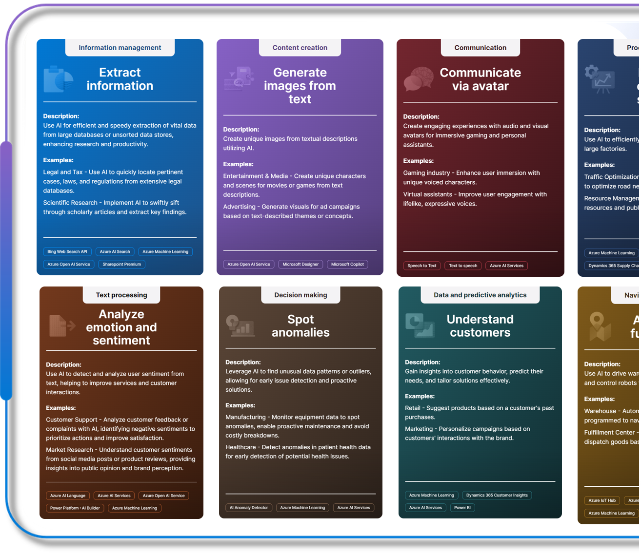

Empower everyone to discover the best opportunities for applying AI.
Notes:
Time: ​
2 min
​
Do:​
Explain the purpose of the cards: Focus on AI functionality. This allows everyone to take part without getting bogged down by technical details.
Say:
The purpose of using the cards is to have a different type of conversation and to show the customer that we’re actively listening while properly exploring their topics and developing their ideas. Design Thinking is about empathizing with the participants in a very engaging way, and it helps to get them invested in the best ideas they've been generating.
Here we show some examples of the cards that we use in this workshop. Each of them has a description at the top of an activity or a capability that we can service with AI. The focus is on the abilities or the activities rather than the technology in Azure / Copilot in the M365 Suite.
Categorize according to human capabilities: What humans can do gives us an understanding of what AI can do, too.
Empower everyone to discover the best opportunities for applying AI:
Why? Interaction with the cards makes AI fun and, in turn, makes identification of use cases easier and fun. It’s a game changer because we democratize the process of envisioning new AI use cases. The cards enable us to connect with every stakeholder in all rooms of the house, and they ensure that we identify those user cases with a real business impact.
How? By not just using the cards alone. It’s best to build this Design Thinking approach with the use of the “AI Discovery Cards” as an add-on approach.

Slide 11
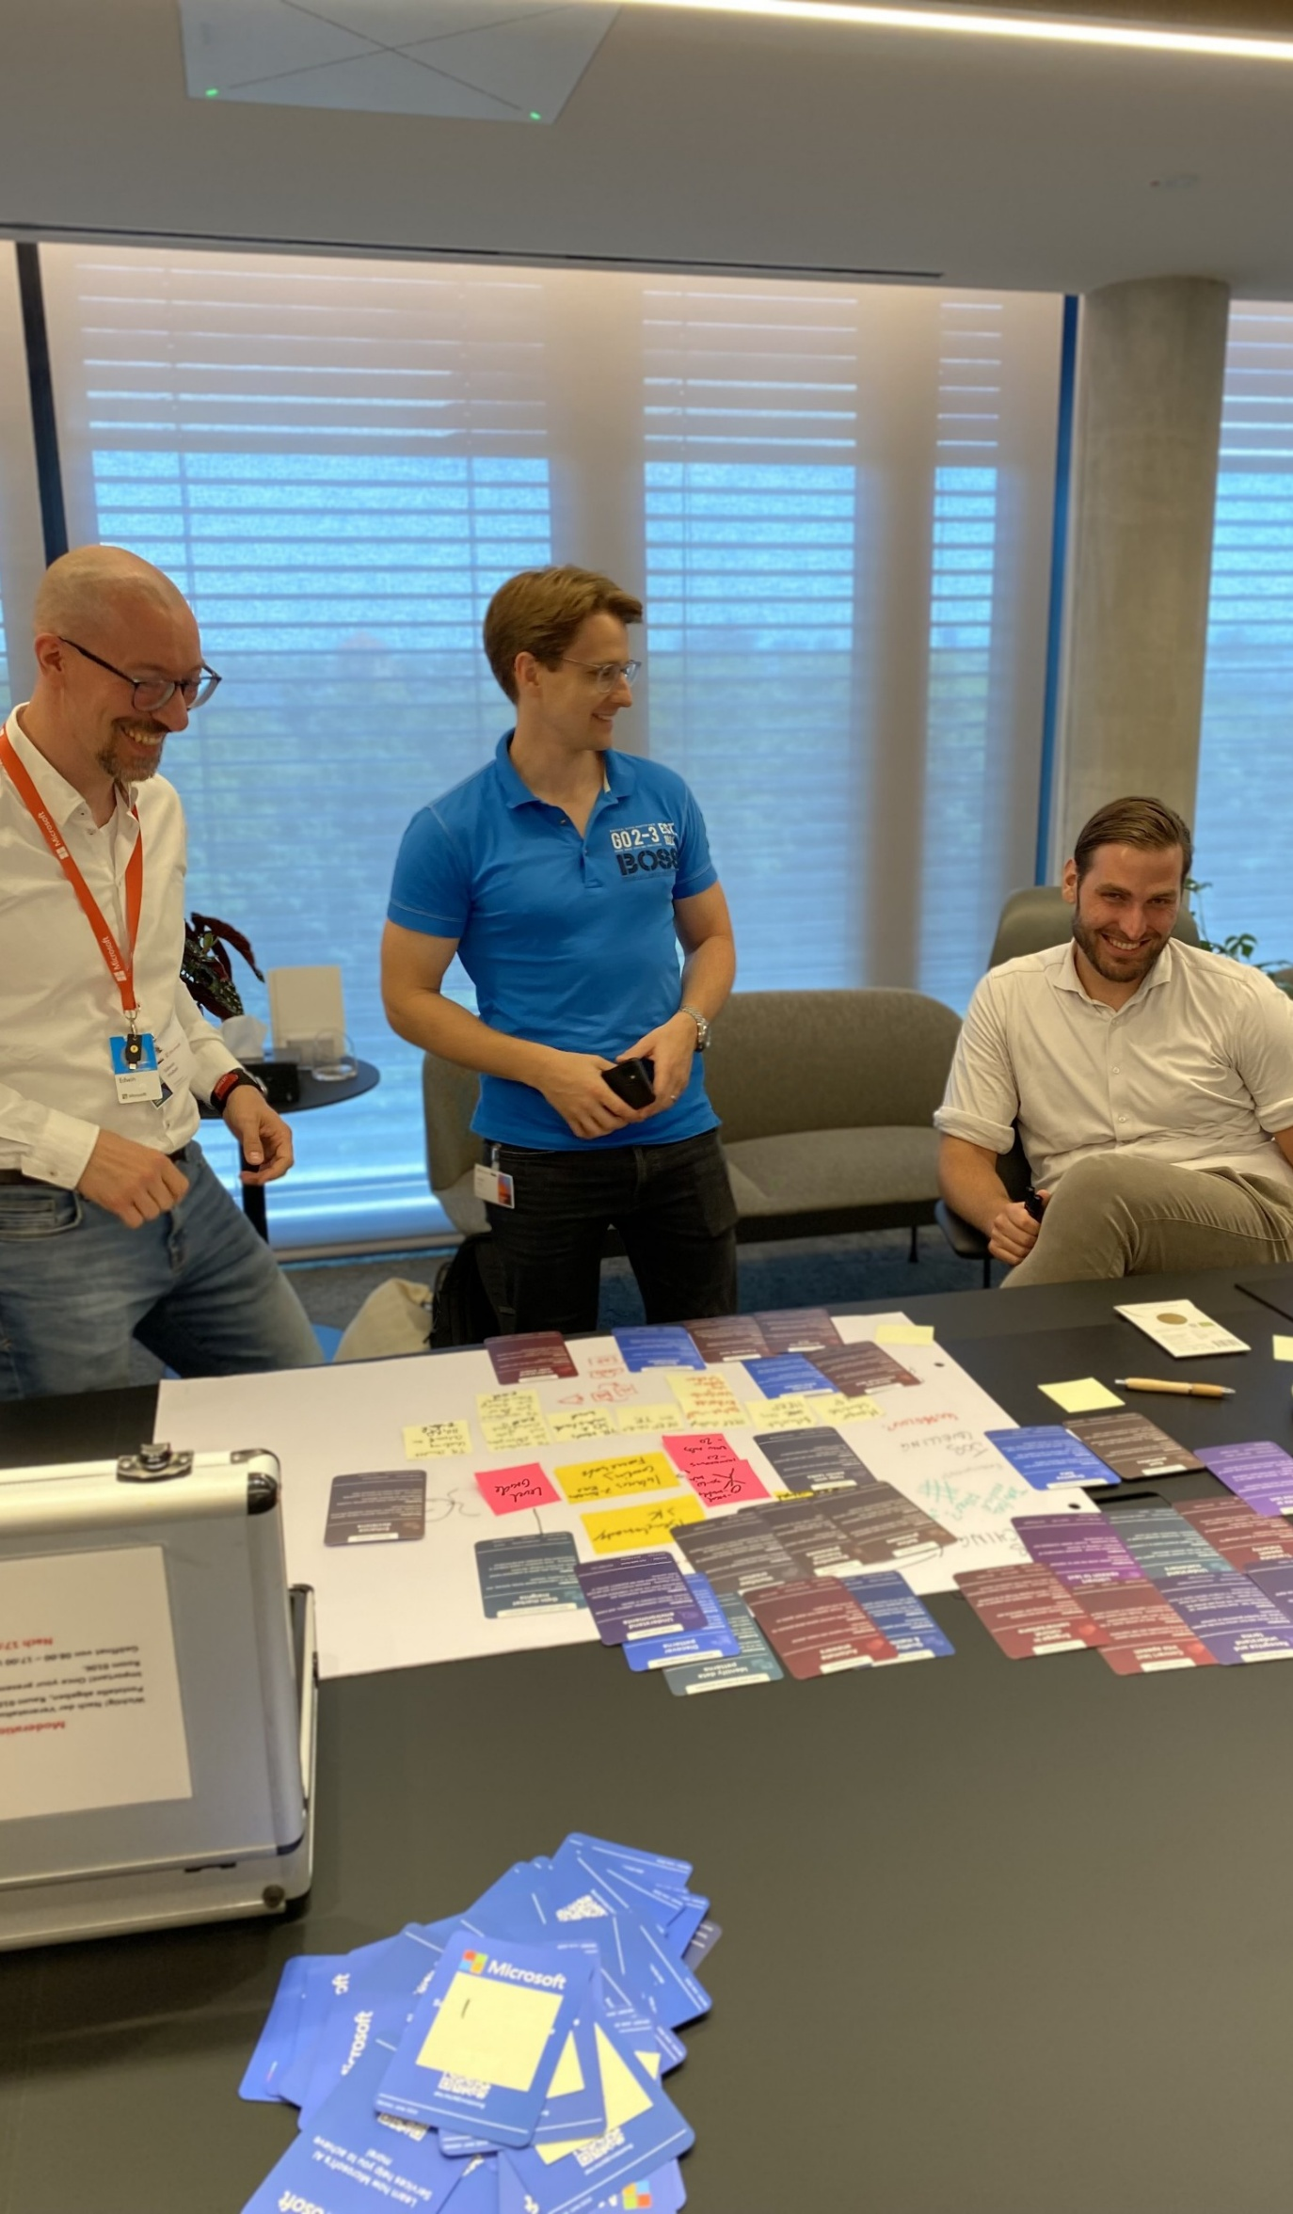
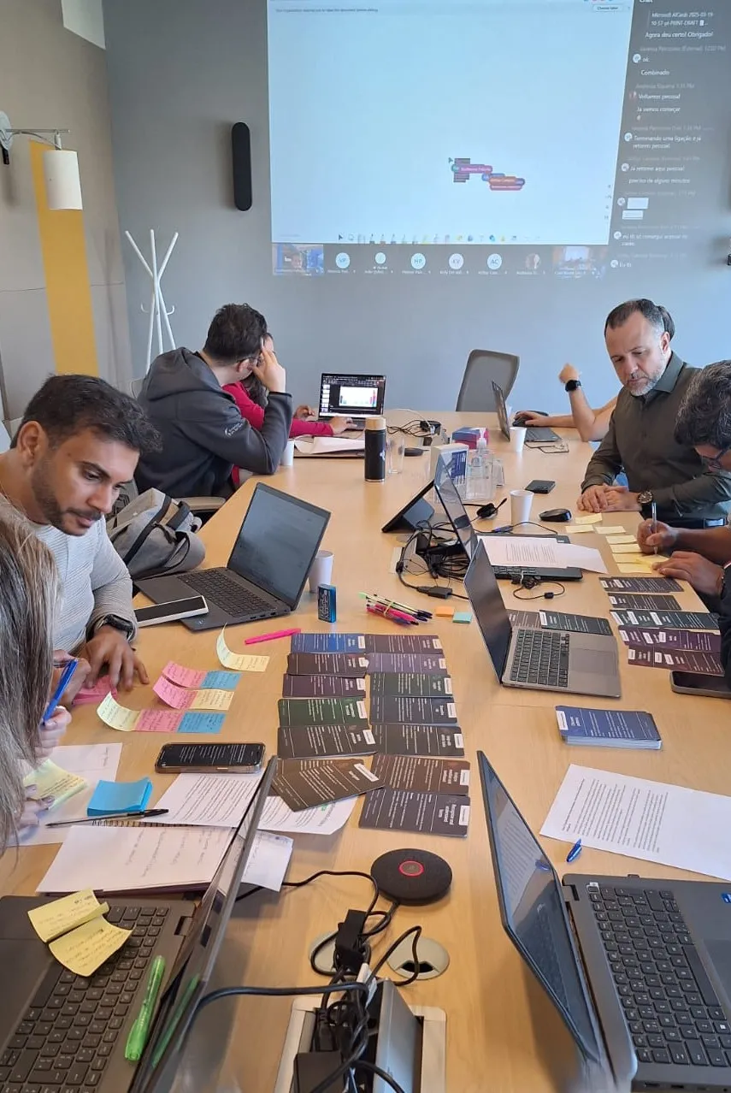
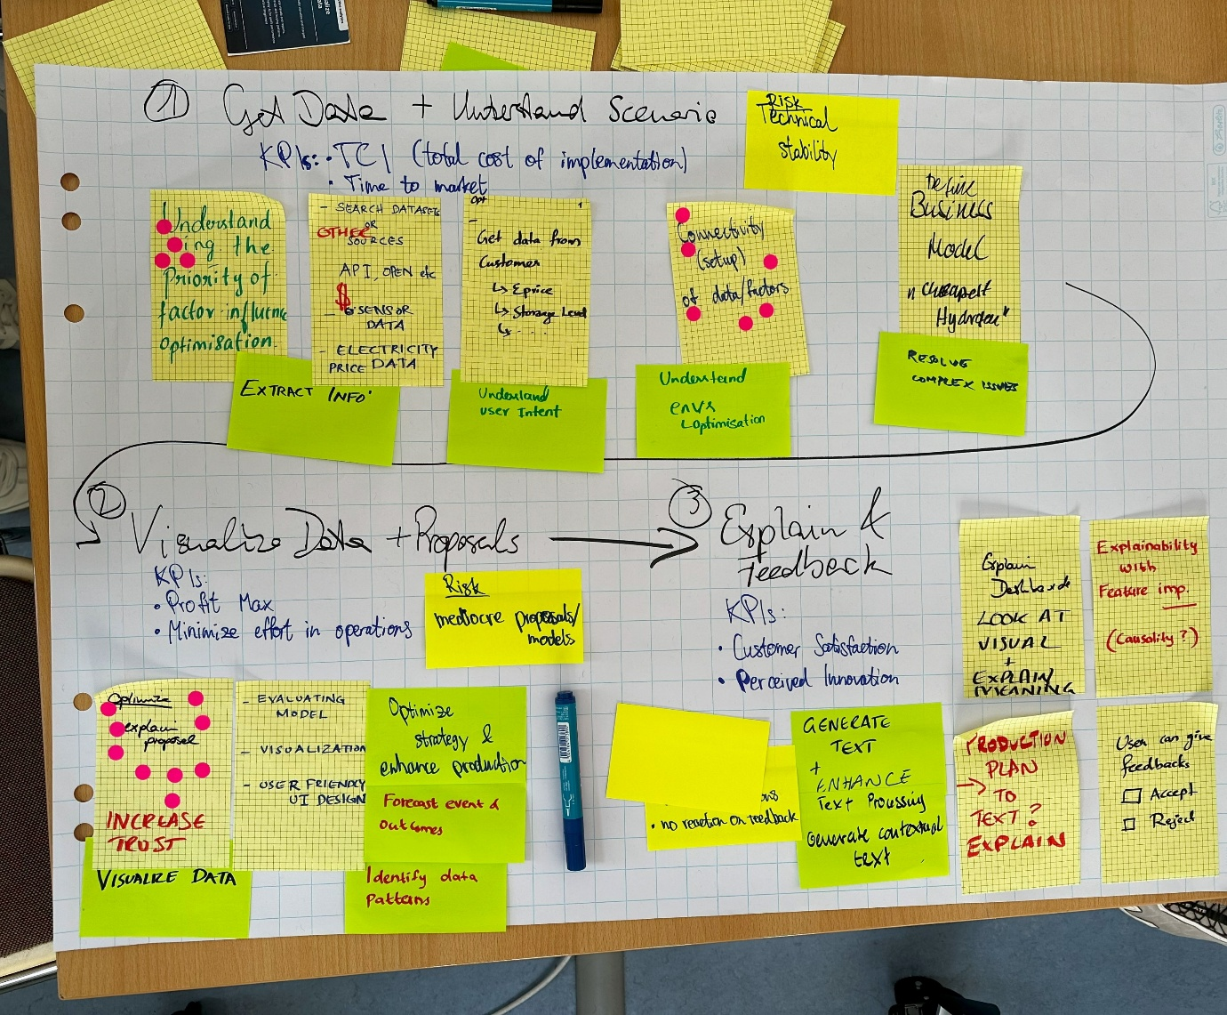
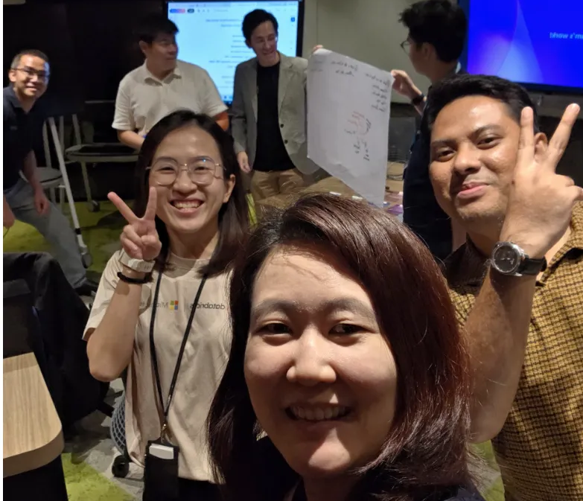
Notes:
Time: ​
1 minute
​
Do:​
N/A
​
Say: ​
We have now been running these workshops successfully with partners world wide, from Brazil, Columbia, UK,, Netherlands, Germany, Singapore and Australia to name just a few.
Sis, SDCs, as well as customers, have shown great results.
Why are the cards so special? Showing and experiencing are always better than just telling, especially when it's challenging and complex!
For this reason, we are going to give you a very quick introduction before we dive into a sample scenario for using the cards.
The purpose here is to show that you can use Design Thinking concepts and take advantage of the cards without being a Design Thinking expert.
After the practical exercise, we’ll dive a little deeper into the methodologies, concepts, and techniques we use during these workshops.
The cards can be used in many ways, but we are going to show you them in the context of a packaged workshop, designed to explore and prioritize use cases for a business function, over the course of a day long workshop.

Slide 12
Facilitator toolbox
2

Slide 13
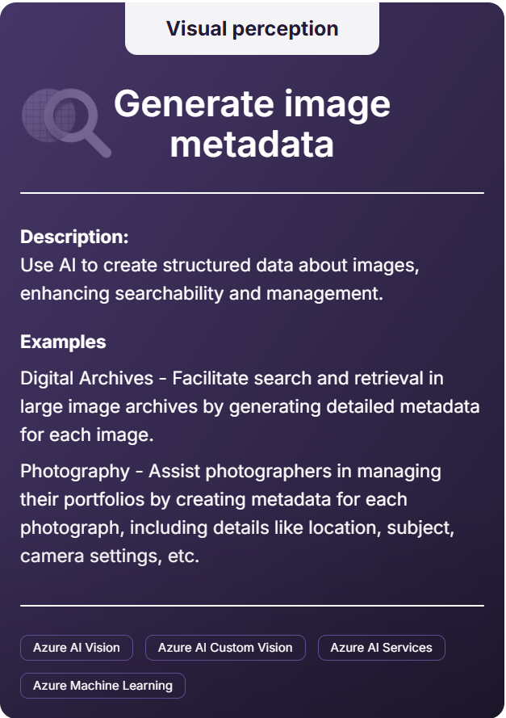
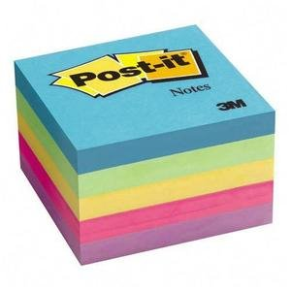
The Toolbox – Materials (in-person facilitation)
Category
Materials to prepare:
79 physical cards that showcase specific AI use cases. Tangible and easy to grasp.
Flipchart or Whiteboard
Sticky notes
Pens and markers
Title
Description
Examples
AI services
Notes:
​Time: ​
30 seconds
​
Do:​
​N/A
Say:
For holding in person workshops, these are the tools that we typically use:
Microsoft AI Cards: We have 79 physical cards that showcase specific AI use cases. These cards are tangible and easy to grasp, making it simple for everyone to understand and engage with the concepts.
Flipchart or Whiteboard
Sticky notes
Pens and markers
If the workshop location has a large screen, it is also useful to project the facilitator deck with the timings for the various stages of the workshop.

Slide 14
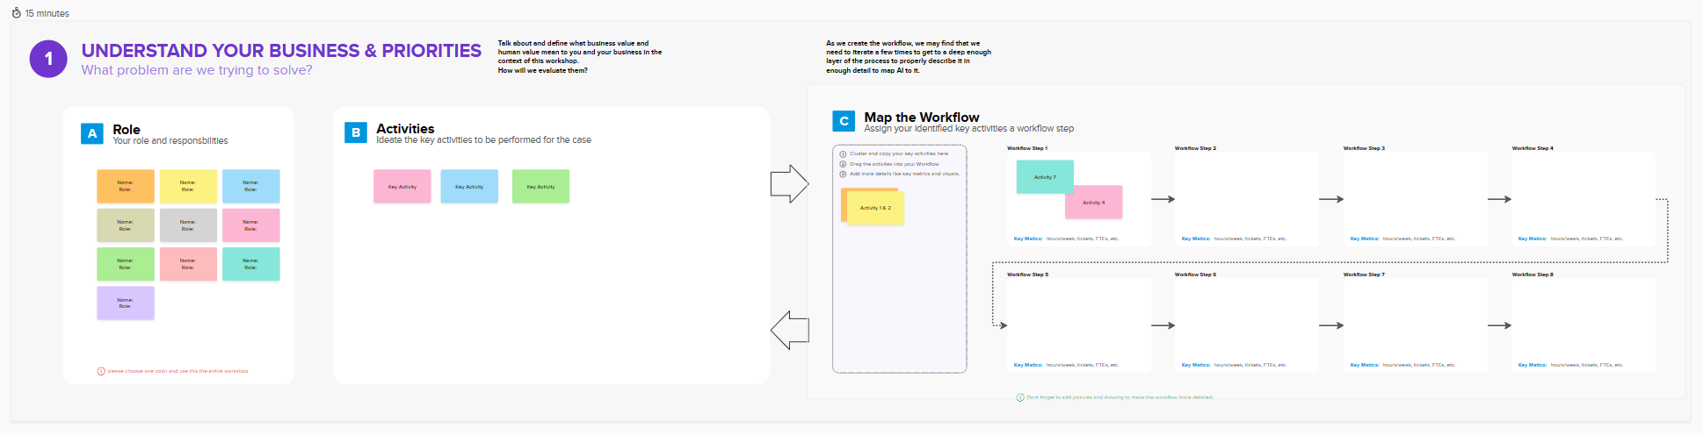
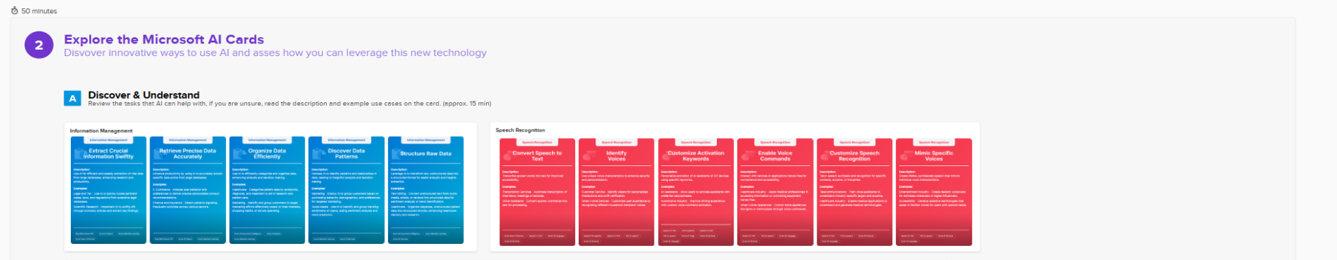
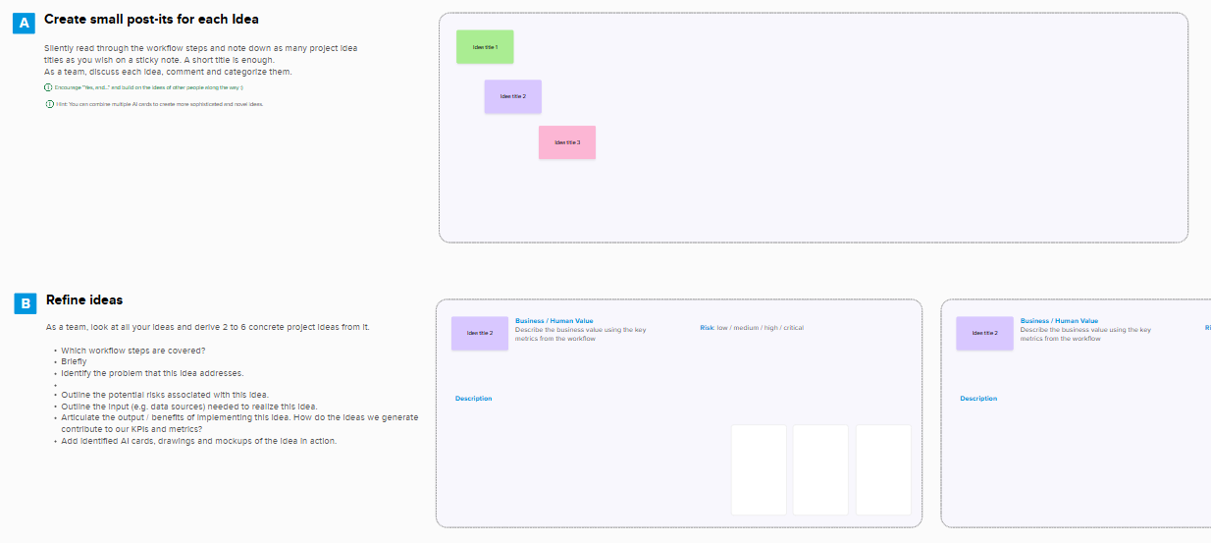
The Toolbox – Interactive board (virtual facilitation)
Interactive Board
Leverage the carefully created, interactive workshop resource to collaborate and ideate quickly and effectively.
Mural: You can request a free subscription (Microsoft internal only). To learn more, read the post Mural License Request at aka.ms/AICardsCommunity
Whiteboard: You have free access to Whiteboard through Microsoft Teams.
Notes:
​Time: ​
30 seconds
​
Do:​
​N/A
Say:
For virtual, digital format workshops, we typically use a cloud-hosted, interactive whiteboard to collaborate and ideate quickly and effectively.
In today’s session, we’ll show you how to do this using a Mural board, which we have prepared especially for this workshop. You can find the links to Mural and Whiteboard in the Train the Trainer Guide.

Slide 15
BXT use-case prioritization template
Use case name:
Department:
Internal or external use:
General
Problem to solve
What’s the challenge/the problem you want to solve? How do you solve it today?
Use case description
What is your idea?
Objectives & key results – Strategic fit assessment
Business objective
Describe the business objective to be achieved?
KPIs and key results
What business KPIs does this use case support? What are the 3-5 measurable key results that will show progress to the objective?
Primary stakeholder who is accountable for OKRs
Role:
Name:
Org/Group:
Strategic fit
1
2
3
4
5
1 = Low and 5 = High
BXT Use Case Assessment.pptx
Notes:
​Time: ​
2 minutes
​
Do:​
​Reintroduce MEEx and BXT.
Say:
To put the workshop in context, here’s an example of a BXT use-case prioritization template. BXT, or the Business Experience Technology model, is aligned to Microsoft Envisioning Experience and our common envisioning framework to ensure that we capture the necessary input to properly assess and prioritize use cases.
<engage with participants>
Which of you have already used MEEx or BXT? Please use the Teams react button.
<Pause to let people react, and then react appropriately to any responses>
The purpose of demonstrating how to incorporate AI Discovery Cards is to provide you with a set of clearly described use cases that contain enough high-quality information to fill out a BXT or CEF-style template, which in turn can be used to evaluate the use cases effectively.
We’ll share where you can learn more about these after this workshop.
<Links for reference, but don’t share with this slide, because participants will be distracted.>
BXT Use Case Assessment.pptx
Microsoft Envisioning Experience (MEEx) L100 - Subject Matter Expert | Viva Learning
Microsoft Envisioning Experience (MEEx) L200 - Business Envisioning for AI - Practitioner | Viva Learning

Slide 16
BXT use-case prioritization template
Use case name:
Department:
Internal or external use:
Business viability – Business impact assessment
How does the use case align to the organization’s executive strategy?
How does the use case contribute to your organization’s executive roadmap/strategy?
How does the use case generate business value?
e.g., additional revenue though a new service or cost saving through higher efficiency
Business change management timeframe
Estimate based on people, tools and processes impact.
Business impact
1
2
3
4
5
1 - 3 months
4 - 6 months
1 = Low and 5 = High
>6 months
Experience value – User desirability impact assessment
Key personas?
Who are the users benefiting most from the concept?
How appealing is the overall value proposition for the user?
What value does this concept offer over the user’s existing next-best alternative to drive adoption?
Change resistance
What level of resistance might be expected to the change?
User desirability
1
2
3
4
5
1 = Low and 5 = High
Technical value – Feasibility impact assessment
What are the implementation and operational risks?
From a software engineering, integration, and data perspective?
Are sufficient safeguards available?
From an information security, responsible AI, compliance, and intellectual property perspective?
AI/LLM fit
Why does this use case require AI/LLM technology as opposed to other alternatives?
Technical feasibility
1
2
3
4
5
1 = Low and 5 = High
BXT Use Case Assessment.pptx
Notes:
​Time: ​
30 minute
​
Do:​
​N/A
Say:
The BXT and CEF templates highlight the questions that we’re trying to answer in this workshop.
We focus on the experience and business aspects of the use cases first. Then, we identify the technical capability and which architecture workshop needs to be performed.
BXT Use Case Assessment.pptx

Slide 17
Workshop activity
3
Notes:
​Time: ​
1 minute
Say:
The goal is to use a framework to get comfortable with the cards with a brief overview of all the process steps. Usually, a workshop is half-a day or a full-day, so keep in mind that we will not go into much detail.
Later we will walk you through how to land and prepare all this for the workshop.

Slide 18
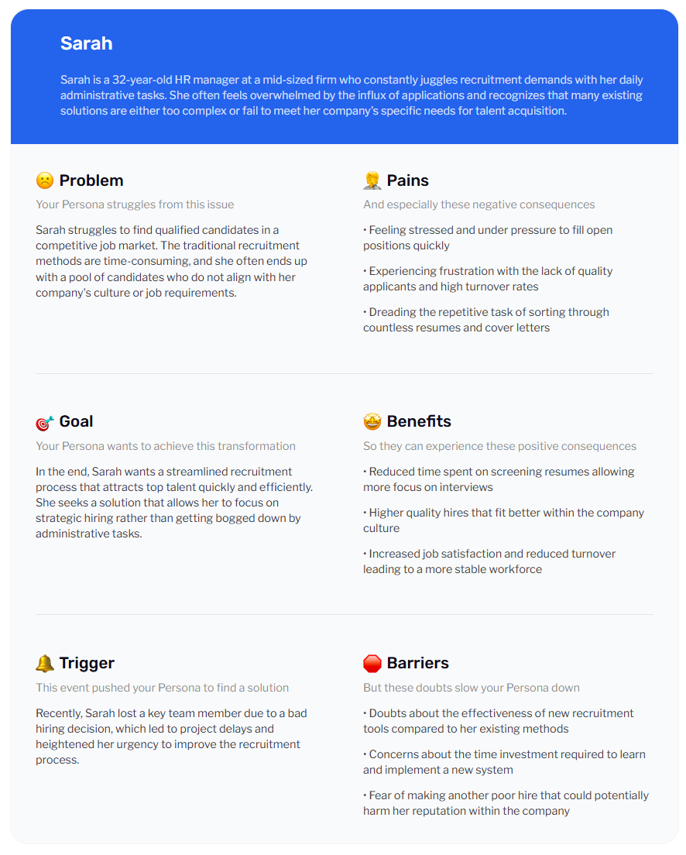
The scenario
2
HR Manager, Talent Acquisition
Current situation: Imagine an HR Manager at a mid-sized tech company struggling to attract and retain top talent. The company is growing rapidly, but the HR team is finding it difficult to fill key positions with qualified candidates. The current recruitment process is lengthy and cumbersome, leading to a high drop-off rate among potential hires. Additionally, the company is not well-known in the industry, which makes it harder to attract top-tier talent.
What is the problem statement?
What is the as-is process?
Created by https://founderpal.ai/user-persona-generator
Notes:
​Time: ​
1 minute
​
Do:​
Refer to the content on the screen to review the scenario with participants and add any additional points you think are relevant.
​
Say:
In a moment, you are all going to see how easy the cards are to use, and apply to a sample scenario.
So, let’s review this scenario together.
Before we take a look at how to use the cards in the ideation workshop, there are a couple of important steps we need to take.
First, we will empathize by conducting interviews with the HR Manager and other stakeholders. This will help us understand their pain points and challenges in the talent acquisition process. Additionally, we will gather insights from current employees about their recruitment experiences.
Next, we will define the persona and problem statement based on the insights we have gathered. For example, we might articulate the problem as: “The HR team needs a more efficient and attractive recruitment process to attract and retain top talent.”
This clear problem statement will guide our ideation process and ensure that our solutions are focused on addressing the real needs of the HR team.
We can also develop and expand on the role of the HR Manager persona. We may also create more personas for other people involved in the scenario that we’re investigating.

Slide 19
Example map | Talent acquisition
User
User’s objective
Candidate gets hired
Recruiter
Notes:
​Time: ​
1 minute
​
Do:​
Refer to the content on the screen to guide the activity with the participants and add any additional points you think are relevant.
​
Say:
We also expect that our participants have prepared some documentation, about the processes that their personas follow, and the activities they engage in.
We visualize this using the “journey map”, which is used throughout the workshop.
We’re going to show you a simplified worked example of how participants might go through the process of creating a journey map, determine relevant KPIs, find matching AI Cards and capabilities, and then create an AI use case.

Slide 20

Example map | Talent acquisition
User’s objective
User
Job posting creation
Contact phase
Screening phase
Interview phase
Post-Interview phase
Post on job boards and company website
Contact potential candidates
Acknowledge information from candidates, outline next steps
Provide feedback to candidates not shortlisted
Evaluate candidates based on their interview performance
Schedule interview with candidates, hiring manager, HR, peers
Recruiter
Pre-screening for shortlist
Update candidates on the interview outcome
Candidate hired
Job posting views
# of contacts
Response rate
% of candidates shortlisted
Interview to offer ratio
Application rate: % of job postings that result in applications
Time to screen and assess
Time to schedule
Time to decision
Attendance rate
Notes:
​Time: ​
30 seconds
​
Do:
​Explain the customer journey.
Say:
In this scenario, you can see that our participants have added some activities that they engage in for HR talent acquisition,
and also indicated where there are critical activities, and how these activities impact their KPIs

Slide 21
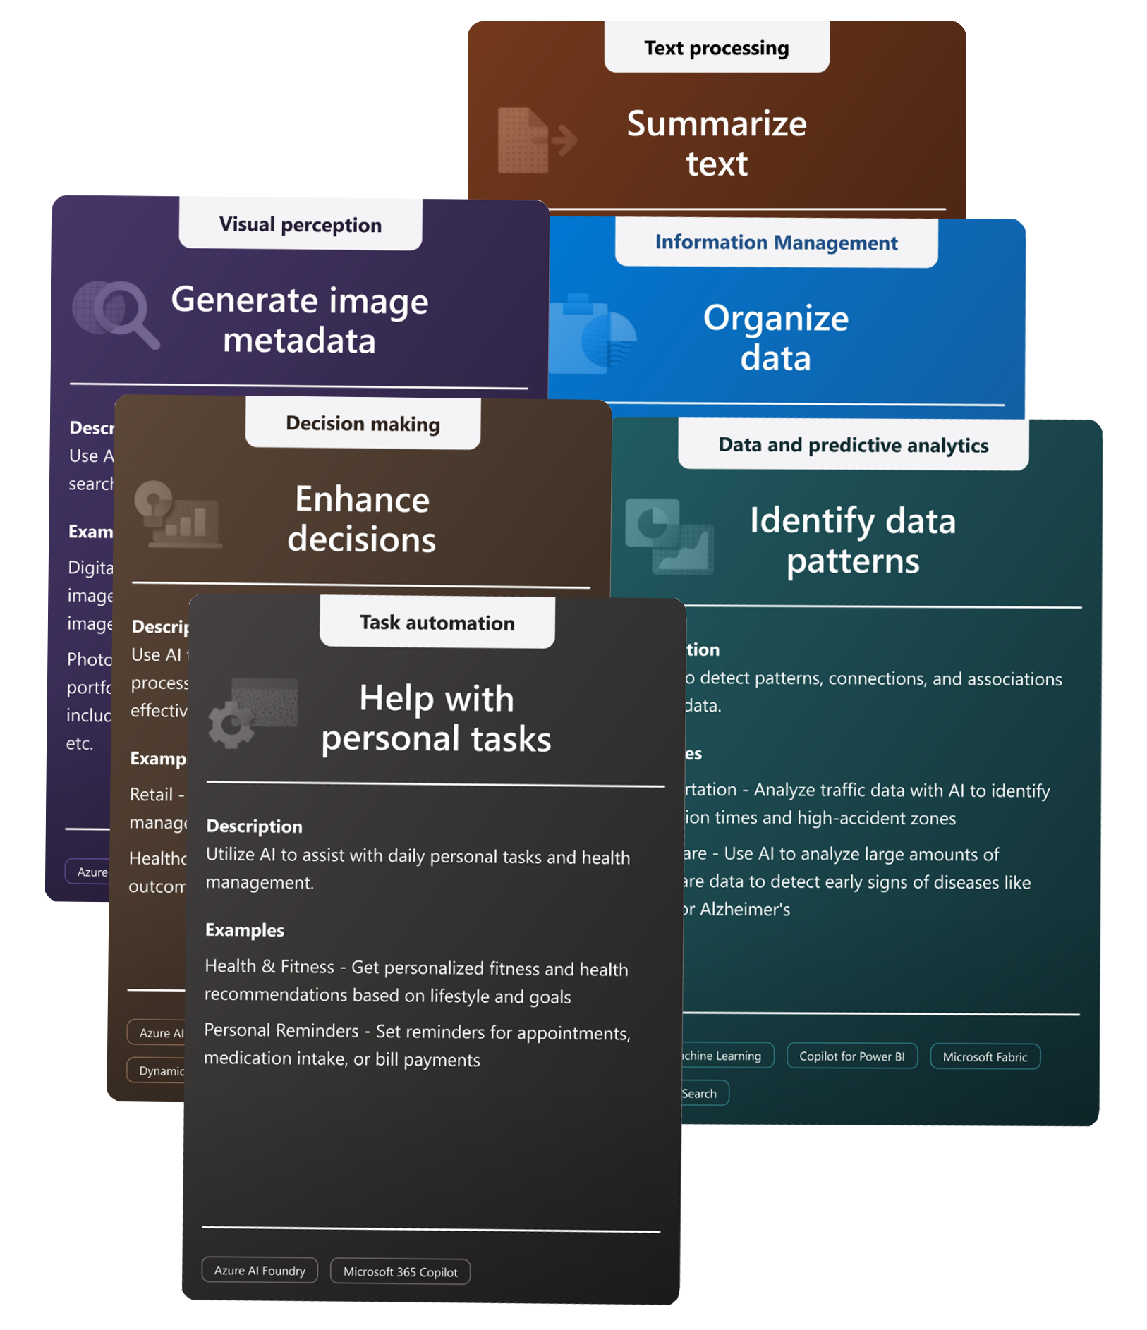
Get to know AI Discovery Cards | Breakout
Activity instructions:
Join your breakout room
Access the activity PowerPoint
Review the AI Discovery Cards
Determine relevance
Map AI Discovery cards to workflow
Collaborate and communicate with your group
Debrief
2
Notes:
​Time: ​
15 minutes breakout
5 min discussion and shareback before break
​
Do:​ Set up the breakout rooms in advance to ensure a smooth transition during the meeting.
To setup a breakout room ahead of time:
Open Meeting Details: Once the Train the Trainer is scheduled, go to your calendar and double-click on the meeting to open its details.
Create Breakout Rooms: In the meeting details, select the Breakout rooms tab. Select Create rooms and choose the number of breakout rooms you need (4 or 5 are suggested for an audience of 20+ participants).
Assign Participants: You can assign participants to rooms either automatically or manually. To assign manually, select Assign participants and select the participants for each room.
Customize Rooms: You can rename each breakout room to reflect its purpose. Hover over the room name, select the three dots (more options), and select Rename.
Save Settings: Once you have set up the rooms and assigned participants, your settings will be saved. When the meeting starts, you can open the breakout rooms with the settings you configured.
Activity instructions:
Objective: In this activity, you will work in groups of 4 or 5 to review a set of AI Discovery cards, understand their content, decide which ones are relevant, and map them to the provided workflow using a powerpoint file.
Steps:
Join Your Breakout Room:
When the breakout rooms are opened, you will be automatically moved to your assigned room.
If you encounter any issues joining the breakout room, select on the Breakout rooms icon in the meeting controls and select your assigned room.
Open the PowerPoint Deck:
Once in your breakout room, you will receive a link to open a PowerPoint deck.
Open the PowerPoint file and choose a participant to share it.
Review scenario and AI Discovery Cards:
As a group, read and understand the content of the activity. (Review slides 26, 27, and 28 to explain the activity)
Read the provided scenario.
Discuss with your group which AI Discovery cards are relevant to the provided workflow.
Consider the goals, challenges, and key characteristics of the workflow.
Map Cards to Workflow:
Drag and drop the relevant AI Discovery cards onto the appropriate sections of the workflow.
Ensure that each card is placed in a way that clearly shows its relevance to the workflow.
Collaborate and Communicate:
Use the chat feature in your breakout room to communicate with your group members.
Return to Main Meeting:
When the breakout activity is over, you will receive a notification to return to the main meeting.
Select on Return in the breakout room controls to go back to the main meeting space.
Share your findings with the group.

Slide 22
Break 10 minutes
Notes:
​Time: ​
30 seconds
​
Do:
​N/A
​
Say:
Let’s take a 10 min break!

Slide 23
Design Thinking: Example scenario
4

Slide 24
Poll questions
How familiar are you with the concept of Design Thinking?
Very familiar
Somewhat familiar
Not familiar at all
2. Which area of Design Thinking are you most familiar with or have you used the most?
Empathy mapping
Ideation
Defining the problem
Creating personas
Notes:
Time: 5 minutes
Note: These poll questions are designed to be used as needed. Feel free to deploy them based on how the interaction unfolds, ensuring they best fit the context and engagement level of your audience.
Do: To create the poll questions:
Open Teams: Go to the chat or channel where you want to create the poll.
Select Polls: Select on the Polls icon. Or select the More options (three dots) and find Polls.
Create Poll: Enter your question and options. You can add more choices by selecting Add option.
Multiple Answers: If you want to allow multiple answers, turn on the Multiple answers toggle.
Preview and Send: Select Preview to review your poll. If everything looks good, select Send.
Your poll is now live, and participants can vote by selecting their choice(s) and selecting Submit vote.
Say:

Slide 25

Introduction to Design Thinking
What is Design Thinking?
Importance of process ideation
Key principles and benefits
Stages of Design Thinking
Our objective
Notes:
Time: 2 min
Do:
Consider engaging with the learners to get feedback and interact on these topics.
For example, ask if anyone has experienced Design Thinking workshops.
This can also help gauge how much time needs to be spent on this review of Design Thinking techniques and principles.
Say:
Now it’s time to explore how we are using Design Thinking.
Could we just have a quick show of hands who has already worked with Design Thinking in some form or another?
Design Thinking is a human-centered approach to innovation that we’re using to integrate the needs of people, the possibilities of technology, and the requirements for business success. It’s really important in process ideation because it helps identify innovative solutions by deeply understanding the participants.
The key principles of Design Thinking include empathy, defining problems clearly, ideating potential solutions, prototyping, and testing. These principles help ensure that solutions are effective and user-friendly.
The five main stages of Design Thinking are:
1. Empathize: Understand the needs of those you're designing for.
2. Define: Clearly articulate the problem.
3. Ideate: Generate a range of ideas.
4. Prototype: Build real, tangible representations for a range of your ideas.
5. Test: Try out your ideas and solutions with users.
We use Design Thinking to consider and discuss the customers’ business processes and activities to find the best use cases for AI.
We’ll provide you with a brief overview of how we use this in the workshop to enhance process ideation, making it more inclusive, user-centered, and innovative.
By the end of this workshop, you'll have a better understanding of how to apply these techniques.

Slide 26

Design Thinking resources
Our workshop will focus on the use of AI Discovery Cards and will not cover all Design Thinking methodologies.
For a deeper dive, please refer to these resources:
IDEO | Design Thinking workshop
IDEO | Design Thinking resources
Sandford | Tools for taking action
Miroverse | Design Thinking workshop
Notes:
​Time: ​
3 minutes
​
Do:​
N/A
Say:
Our workshop will focus on the use of AI Discovery Cards and will not cover all Design Thinking methodologies.
We’ve developed this approach using specific Design Thinking techniques and steps to provide clear guidelines for delivering the workshop effectively.
However, there are many additional tools available in the Design Thinking toolbox that you can use.
Feel free to allow yourself as much flexibility as possible to adapt and enhance the workshop.
For a deeper dive into Design Thinking methodologies and tools, please refer to the resources on screen. I will also put them in our MS Teams chat.

Slide 27
Personas
Notes:
​Time: ​
1 minute
Do:
N/A
Say:
N/A

Slide 28
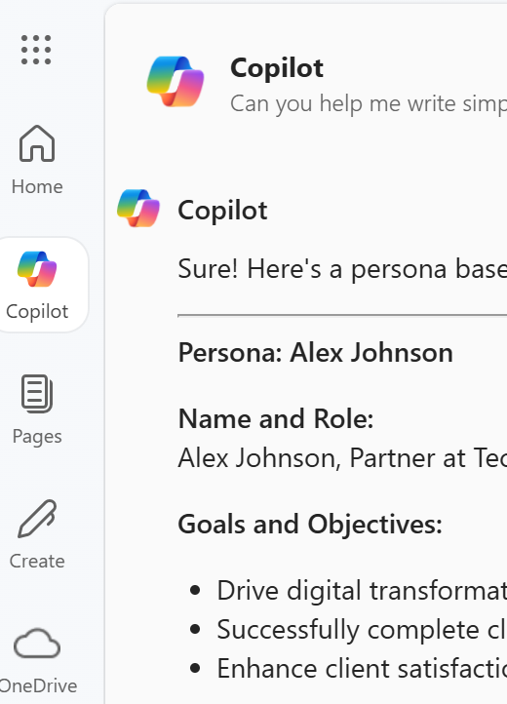
Create a persona using Copilot | Demo
Step 1: Let's start by reviewing the meeting notes provided. Pay attention to key details about the participants, their roles, and any specific challenges or goals mentioned.
Step 2: Next, we will create a persona using the information from the meeting notes using Copilot. Here’s the prompt we will use: Please create a persona using these meeting notes and include the following details:
Name and role
Goals and objectives
Pain points and challenges
Key characteristics and behaviors
2
Notes:
​Time: ​
10 minutes – Includes 3 minutes intro and demo
3 minutes participants trying this out.
4 minutes shareback.
​
Do:​
Workshop activity: Creating a persona with Copilot
Objective: Participants will learn how to create a detailed persona using information gathered from client meetings and Copilot.
Materials Needed:
Access to Copilot
Notes from recent client meetings
Say:
Creating personas is vital to help participants in a workshop understand, empathize with and address needs.
They help us understand what the people who are involved in the business functions and activities that we are looking to address, actually do, and how they feel about their challenges.
Copilot can assist in gathering and organizing information to create accurate personas, or you can use persona creation tools that are available online.
Demo:
Step 1: Share the meeting notes provided for this demo. Review key details about the participants, their roles, and any specific challenges or goals mentioned.
Step 2: Next create a persona using the information from the meeting notes using Copilot. Use this prompt and copy and paste the meeting notes after the prompt:
Please create a persona using these meeting notes and include the following details:
Name and role
Goals and objectives
Pain points and challenges
Key characteristics and behaviors
Meeting notes:
Date: January 21, 2025 Attendees:
PSA Representative
Partner - Project Manager
Partner - Business Analyst
Objectives:
Discuss the current status of the ongoing project.
Identify any challenges or roadblocks.
Align on next steps and deliverables.
Discussion Points:
Project Status Update:
PSA: Provided an overview of the project's progress, highlighting key milestones achieved so far.
PM: Shared updates on the partner's side, mentioning that the development phase is on track.
Roles and Responsibilities:
PSA: Responsible for overseeing the project implementation and ensuring alignment with Microsoft’s standards.
PM: Manages the project timeline and coordinates with the development team.
BA: Analyzes business requirements and ensures that the project meets the partner's needs.
Objectives:
PSA: Ensure the project is delivered on time and within budget while meeting quality standards.
PM: Achieve seamless integration of the PSA system with the partner's existing processes.
BA: Ensure that the final solution addresses all business requirements and improves operational efficiency.
Challenges:
PSA: Mentioned the challenge of managing resource allocation due to overlapping projects.
PM: Highlighted the difficulty in coordinating with remote teams and ensuring consistent communication.
BA: Pointed out the challenge of aligning the new system with the partner's legacy systems without causing disruptions.
Next Steps:
PSA: Will provide a detailed project plan and timeline for the next phase.
PM: Will arrange a follow-up meeting with the development team to address any technical concerns.
BA: Will gather additional business requirements and share them with the team for further analysis.
​
Say: (Explain the activity above)

Slide 29
Hands-on exercise: Whiteboard
5
Notes:
​Time: ​
1 minute
Do:
N/A
Say:
N/A

Slide 30
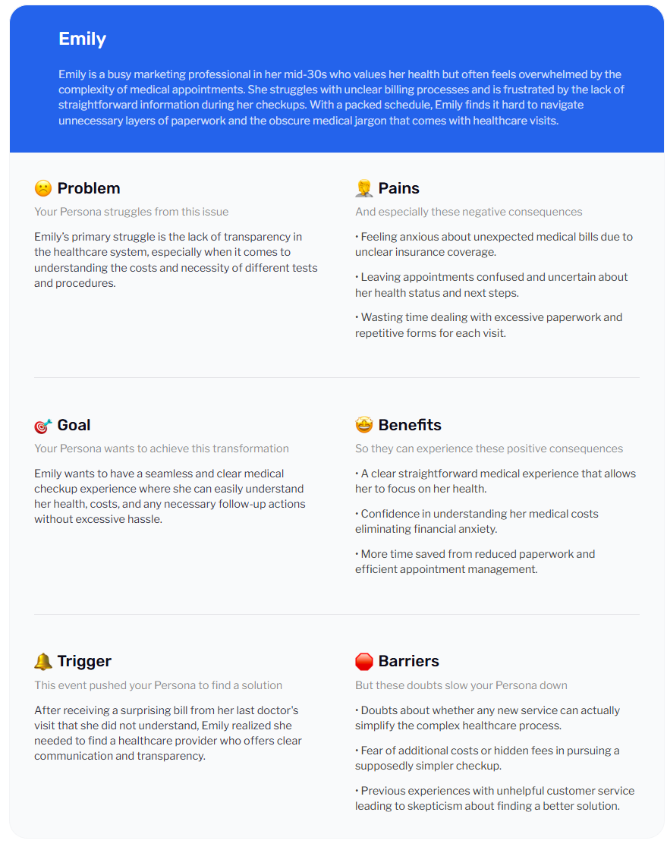
Scenario: Medical appointment with a doctor
2
Example workflow:
Patient requests an appointment and waits for confirmation.
Patient arrives at doctor’s office.
Receptionist provides forms to the patient; patient fills out forms.
The receptionist creates the patient profile in the system and enters the data.
Consultation with the doctor.
Documentation and treatment plan.
Follow-up and next steps (prescriptions and administrative tasks).
Created by https://founderpal.ai/user-persona-generator
Notes:
​Time: ​
1 minute
​
Do:​
Refer to the content on the screen to review the scenario with the participants and add any additional points you think are relevant. Make sure you explain the steps in each section of the demonstration before performing the steps. Tell them what you are about to do, do it, and then tell them what you did.
Once introduced to the scenario, we switch to the Mural board for the workshop activities in Mural.
​
Say:
We have a few example scenarios that we use with learners to understand how to use and apply the AI Discovery cards to their use cases.
Today we are going to jump right into a scenario that we hope you will all be familiar with or be able to empathize with to some degree: a medical check up.
Let’s review this scenario and the steps of the workflow before we take you through the Mural board activity.
<go through the workflow>
Now let’s jump over into the whiteboard, and we shall simulate the activities that we use to create and prioritize our use cases./
(this is a 40 minute exercise to take learners through the stages of the AI Discovery Cards activities, once the initial customer journey map has been created). Points to note:
Options to extend the activities in the journey map, and facilitators should review journey map granularity
Options for multiple passes on voting steps.
Filtering cards
Options for multiple p[asses on voting and aggregating and consolidating votes.

Slide 31
Process overview
6

Slide 32
Process overview SI/ISV partners
PTS/PSA and partner align on next steps to support customer deliveries & remove blockers.
ISV: PTS/PSA aligns on next steps to prioritize use cases, create POC, update roadmap and TDP.
PTS/PSA meets with the partner to understand their journey, schedule the workshop, and then follows up via email with a one-pager and necessary preparation information. TDP Updated.
PTS/PSA delivers the workshop to the partner (4-hour session).
STEP 1 | T-5 Weeks
Land the workshop
STEP 2 | T-4 Weeks
Prepare the partner for the workshop
STEP 3 | T-1 Week
Prepare to deliver the workshop
STEP 4 | T
Deliver the workshop
STEP 5 | T + 1 Week
Follow up with partner
STEP 6 | T + 2 Weeks
Support and next steps
PTS/PSA pitches the workshop to partners and sends out invitations.
ISV: Remember to plan two sessions, the use-case discovery, and then the technical workshop.
PTS/PSA gets prepared to deliver the workshop either virtually or in-person by reviewing PowerPoint deck and online guide.
PTS/PSA follows up with partner. Targets accounts and commitment on number of workshop deliveries added to TDP.
ISV: PTS/PSA follows up with partner by sending the results of the of the workshop. Plans Technical Capability or appropriate Tech Workshop.
Notes:
Time:
5 Minutes
Do:
N/A
Say:
Here we have provided a timeline to help you understand roughly how long you can expect to take to plan and execute delivery with your SI partners.
Remember that ISVs will be treated more like a customer. This means you will need to plan the technical workshop as well as the use-case discovery.
We have also found that some ISVs will want to run the workshop with their own customers after they have experienced it, as a way to validate their assumptions about AI features they are adding to the roadmap. This might be something that you need to bear in mind when looking at the roadmap, TDP timelines, and commitments they make.

Slide 33
Recommended participants
A multifunctional team
Partners
Mix of decision makers and contributors
Facilitators
Change agents
Chief Product Officers / Product owners / Process owners
Managers / Sales managers
Digital Transformation Managers / Innovation Managers
Data & AI Specialists
Partner-facing roles:
Sales
Consultants
Solution professionals
Product owners
Data & AI professionals
Notes:
​Time: ​
2 minutes
Do:​
N/A
​
Say: ​
Let's talk about something really important: the mix of decision-makers and contributors in a multifunctional team.
<Engagement, Ask>
Does anyone have an idea as to why we mix these two groups together?
</ask>
<Acknowledge response, react accordingly before proceeding>
Decision-makers have a top-down view of the process.
They have the big picture, like how the overall production is going or why certain targets aren’t being met.
But the contributors?
They know what works and what doesn’t on the ground.
When a process isn’t working well, contributors are often the ones who find clever workarounds to keep things moving smoothly. For instance, if someone opens a new support ticket, they might call the manager directly to expedite it. Or if there’s an issue on the production line, they know to contact their friend Celia, the line manager, to reset the conveyor belt.
So, having both perspectives is crucial. Decision-makers can spot overarching challenges, like slow production rates or lower numbers on Fridays, but they might not know the specific reasons why these issues are happening. Contributors, on the other hand, understand the nitty-gritty details of the processes and can pinpoint exactly what needs improvement.
This mix ensures that we get a comprehensive understanding of the issues and can develop solutions that actually work. It's super important to have enough contributors who can describe the detailed processes they use to get their work done.
By combining these insights, we can tackle problems more effectively and improve our processes from both a strategic and operational standpoint.

Slide 34
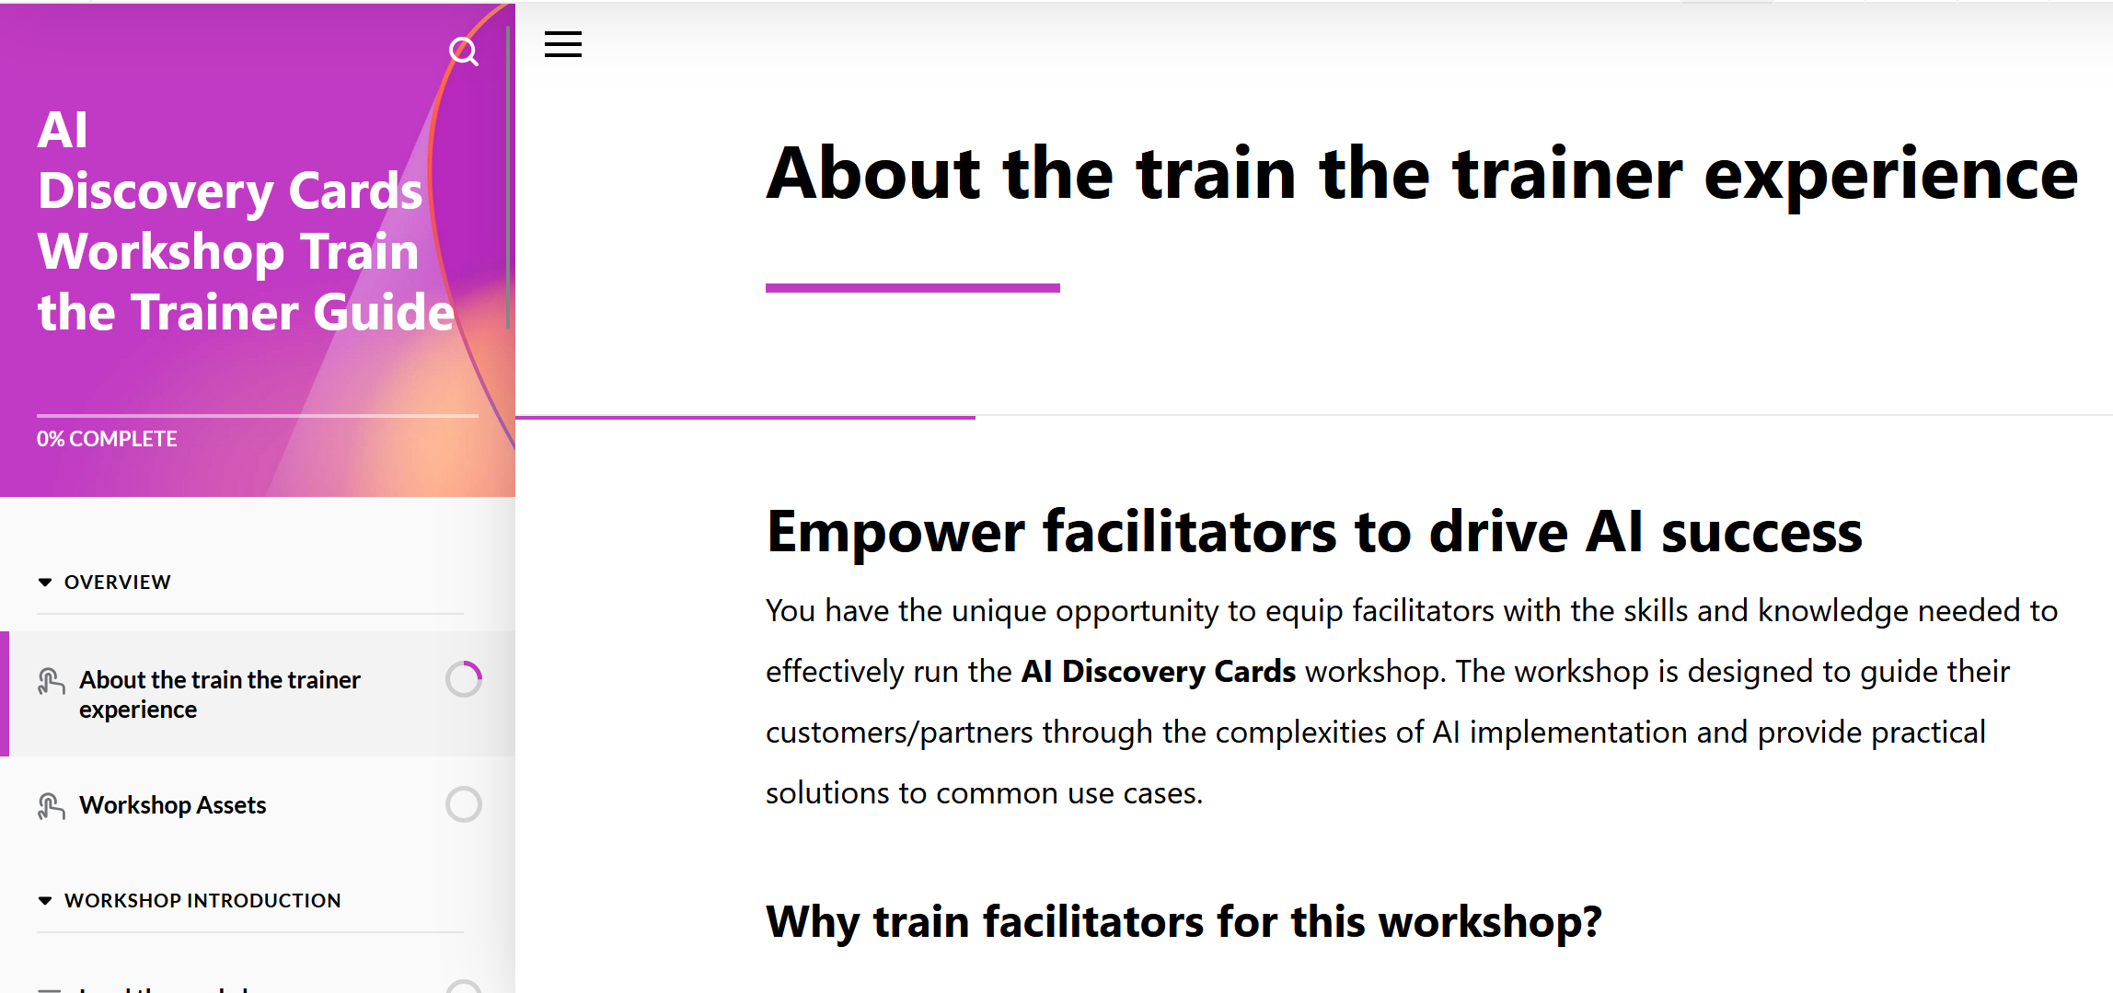
Resources
Select the whiteboard of your choice (Mural or Microsoft Whiteboard). You can find the links to both templates in the Train the Trainer Guide.
AI Discovery Cards Workshop Train the Trainer Guide
Notes:
​Time: ​
3 minutes
​
Do:​
​N/A
Say:
Select the whiteboard of your choice (Mural or Microsoft Whiteboard). You can find the links to both templates in the Train the Trainer Guide.

Slide 35
Break 10 minutes
Notes:
​Time: ​
30 seconds
​
Do:
​N/A
​
Say:
Let’s take a 10 minute break!

Slide 36
Next steps
7
Notes:
​Time: ​
30 seconds
​
Do:
​N/A
​
Say:
N/A

Slide 37

Next steps
Share your plan for the partners you will target for this training by completing the AI Discovery Cards Partner’s Deliver Reporting Form
Join the AI Discovery Cards Viva Engage Community
Request a Mural license
Order AI Discovery Card Workshop physical cards
Notes:
​Time: ​
2 minutes
​
Do:​
​N/A
Say:
Now that you’ve completed the workshop, what’s next? We have four actions for you:
Identify the partners you will target for this training and share your plan with us by completing the AI Discovery Cards Partner's Delivery Reporting Form
Join the AI Discovery Card Viva Engage Community to receive important announcements to support your preparation to land this workshop with your partners.
Request a complimentary Mural license if you don’t already have one.
Order physical cards for your in-person AI Discovery Cards workshops
Let’s discuss these steps further…

Slide 38

AI Discovery Cards Partner’s Delivery Reporting Form
Identify the partners you will target for this training and share your plan by completing the AI Discovery Cards Partner's Delivery Reporting Form
Notes:
​Time: ​
2 minutes
​
Do:​
Post this link in chat: https://forms.office.com/r/YkFmVAdnfG
​
Say:
To enable us to report on execution, partners readiness and influence FY26 strategy, GPS Skilling is asking that you Identify the partners you will target for this training and share your plan with them by completing the AI Discovery Cards Partner's Delivery Reporting Form

Slide 39
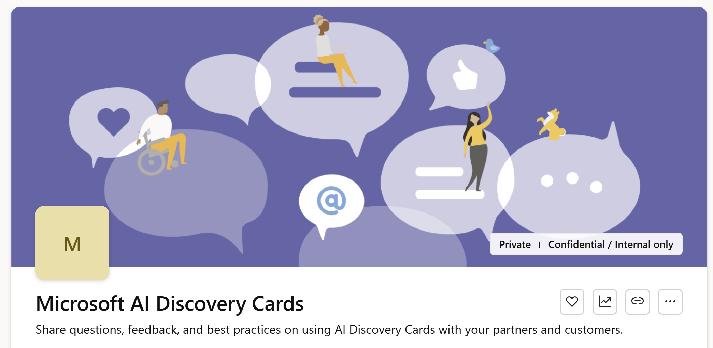
AI Discovery Cards Viva Engage community
Learn. Share. Connect.
Join the Microsoft AI Discovery Cards Viva Engage community at: https://aka.ms/AICardsCommunity
Receive important announcements, updates to cards and TtT content!
Notes:
​Time: ​
2 minutes
​
Do:​
Post this link in chat: https://aka.ms/AICardsCommunity
​
Say:
Now that you have completed this workshop, please join the Microsoft AI Discovery Cards VIVA Engage community. This space is designed to help you continue learning, share insights, connect with fellow learners. It is also where we post important announcements to support your preparation to land this workshop with your partners. I encourage you all to join today.
The community is also where you can get the latest versions of the cards and TtT content.

Slide 40
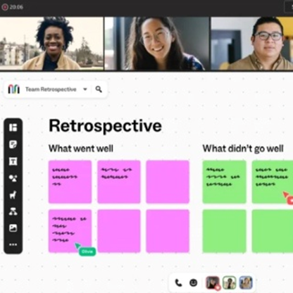
Mural License
Enhance your workshops and request a complimentary Mural license (Microsoft internal only).
To get started, visit the Mural License Request post at aka.ms/AICardsCommunity
Notes:
​Time: ​
2 minutes
​
Do:​
N/A
​
Say:
You can request a free Mural subscription (Microsoft internal only). To get started, visit the Mural License Request post at aka.ms/AICardsCommunity

Slide 41
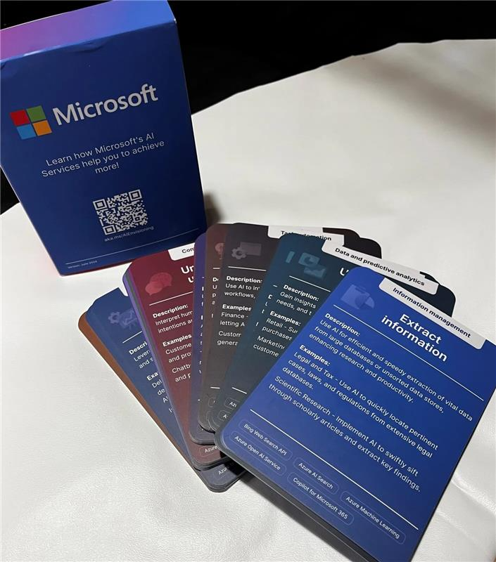
AI Discovery Cards Workshop Physical Cards
The GPS Skilling team is offering the physical version of the AI Discovery Cards!
To make your order, visit the Sign-Up TODAY for AI Discovery Cards Orders (English version)! post at aka.ms/AICardsCommunity.
Free shipping included!
Please take a moment to complete the survey. Your feedback is crucial for enhancing future workshops.
Notes:
​Time: ​
2 minutes
​
Do:​
N/A
​
Say:
The GPS Skilling team is offering the physical version of the AI Discovery Cards! To make your order, visit the Sign-Up TODAY for AI Discovery Cards Orders (English version)! post at aka.ms/AICardsCommunity. Free shipping is included!
Are there any questions about next steps?
Alright, now let me explain how the .GPS Skilling team is recognizing you and your partners with badges

Slide 42
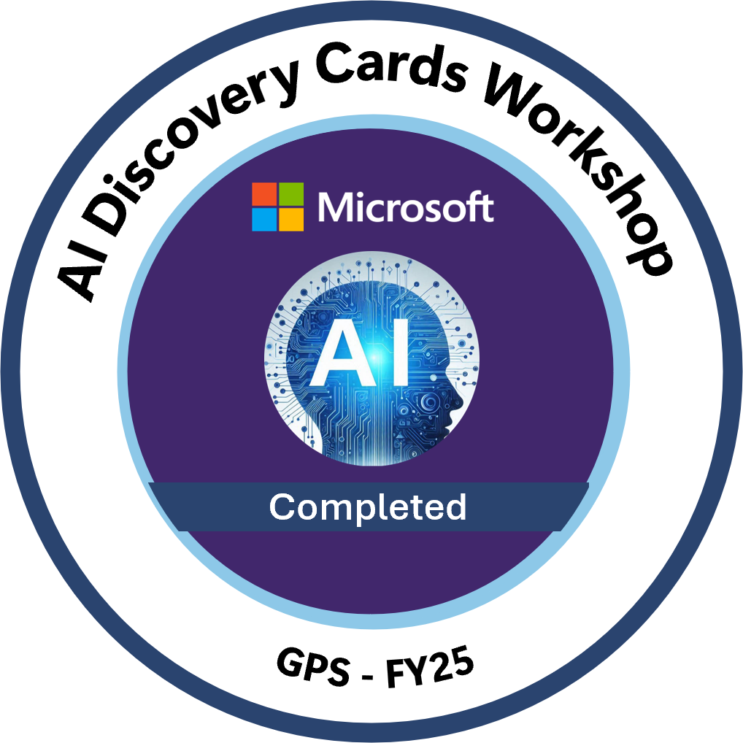
AI Discovery Cards Workshop Badge
Your efforts will be recognized with the AI Discovery Cards Workshop badge!
Upon successful completion, you will receive an email from admin@credly.com.
Share this badge on social media!
Please take a moment to complete the survey. Your feedback is crucial for enhancing future workshops.
Notes:
​Time: ​
2 minutes
​
Do:​
N/A
​
Say:
I want to take a moment to recognize your efforts. You will be awarded the AI Discovery Cards Workshop badge for your participation and hard work. You can expect to receive an external email from Credly (admin@credly.com). This email will contain your badge. Make sure to look out for it and check your junk folder as well.
Once you receive the badge, feel free to share it on social media. It's a great way to showcase your achievement and let others know about your accomplishment.
Your dedication and commitment to learning are commendable. Keep up the great work and continue to apply what you've learned.

Slide 43

AI Discovery Cards Workshop Badge for your Partners
The employees of the partners attending the AI Discovery Cards - Train The Trainer workshops will be recognized with this badge.
To learn about how the badges are issued for partners, visit the Microsoft Badges for your Partners post at aka.ms/AICardsCommunity.
They can share this badge on social media!
Please take a moment to complete the survey. Your feedback is crucial for enhancing future workshops.
Please take a moment to complete the survey. Your feedback is crucial for enhancing future workshops.
Notes:
​Time: ​
2 minutes
​
Do:​
N/A
​
Say:
And more great news, the GPS Skilling team has secured a number of Microsoft badges for you to use to award the employees of the partners attending the AI Discovery Cards - Train The Trainer workshops you have already delivered in FY25 or are planning to deliver in remaining of FY25.
If you have any questions about the badge or the process, please don't hesitate to reach out. I'm here to help.
Please take a moment to complete the course survey. Your feedback is important to enhancing future workshops.

Slide 44
Course survey https://aka.ms/AICardsSurvey
Notes:
TIME: 2 minutes
Do:
Post this survey link in the chat: https://aka.ms/AICardsSurvey
SAY:
Please complete the course survey today while your memory of the experience is fresh. We value your feedback and use it to improve this course and guide the development of future courses.

Slide 45
Thank you!

